Slide 1

“Winlink Express” Pactor setup
(formally RMS Express)
Starting with Airmail 2000 for
HF Radio and SCS Pactor TNC setup

Slide 2
This Power Point will assist you in setting up your HF Radio and SCS Pactor TNC
These are the things you will need to know before you start.
HF RADIO:
Make & Model of your HF Radio
Has the radio got a Serial port or USB to control the radio
What port is it on and the port speed
PACTOR TNC:
Make & Model of you SCS Pactor TNC
Has it got a Serial port or USB to control the TNC
What port is it on and the port speed
Write them down you will need these for use during Airmail & RMS Express setup
HF Radio – Comport ? Speed?
SCS Pactor TNC – Comport ? Speed?

Slide 3
HF RADIO SETTINGS
Newer HF radios have Input and Output level adjustments.
They can be set within the menu system.
Example:
Kenwood TS-480SAT/HX
46 – AF Input
47 – AF Output
Kenwood TS-590
64 – AF Input
65 – AF Output
I find that the Kenwoods are usually best set at 2/2

Slide 4
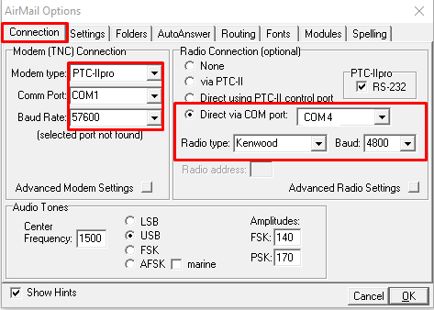
AIRMAIL SETUP
Enter your setting for the TNC & Radio

Slide 5
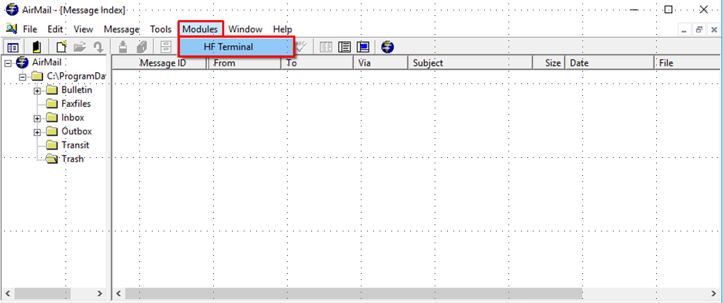
Starting AIRMAIL (latest ver. 3.4.062b)
Modules/HF Terminal and make sure the radio and TNC initialize ok

Slide 6
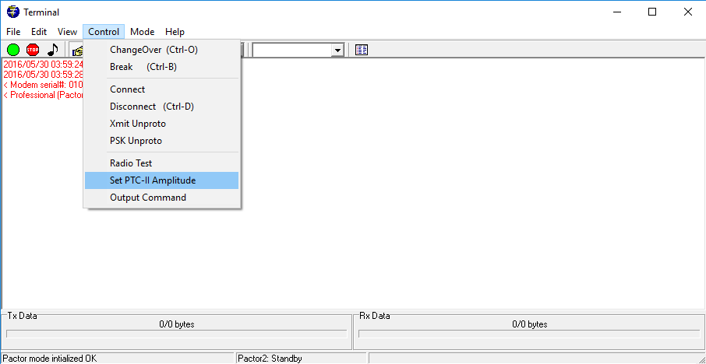
AIRMAIL (latest ver. 3.4.062b)
Now go to Control/Set PTC-II Amplitude

Slide 7
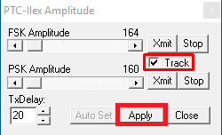
AIRMAIL (latest ver. 3.4.062b)
Then in Set PTC-II Amplitude untick the “Track” box then Apply it

Slide 8
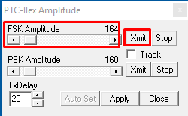
AIRMAIL (latest ver. 3.4.062b)
Note: Radio will transmit when Xmit is clicked
Then in Set PTC-II FSK Amplitude click on Xmit
Adjust - Slider for fast or < > for slow movement while setting transmit for NO ALC
Note: Write down the number in the FSK Amplitude indicated at the top right corner of red box

Slide 9
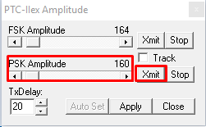
AIRMAIL (latest ver. 3.4.062b)
Note: Radio will transmit when Xmit is clicked
Then in Set PTC-II PSK Amplitude click on Xmit
Adjust - Slider for fast or < > for slow movement while setting transmit for NO ALC
Note: Write down the number in the PSK Amplitude indicated at the top right corner of red box

Slide 10
AIRMAIL (latest ver. 3.4.062b)
At this point you will have the following information.
HF Radio – type of comport, USB or Serial and it ‘s Comport number along with the baud speed
SCS TNC – type of comport, USB or Serial and it ‘s Comport number along with the baud speed
SCS TNC – Level numbers for FSK & PSK

Slide 11
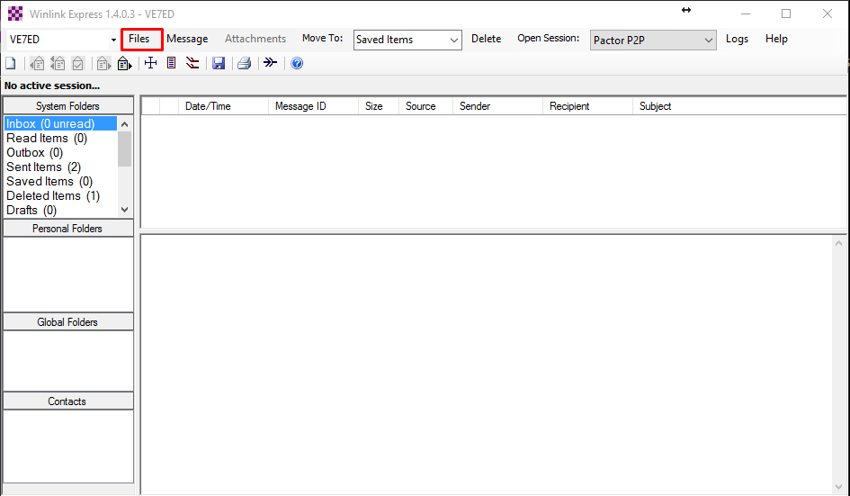
Winlink Express (latest ver. 1.3.14.0 or newer)
At this point you will enter the setup information that you have written down
In the following screens.
Start - RMS Express and Files/Winlink Express Setup

Slide 12
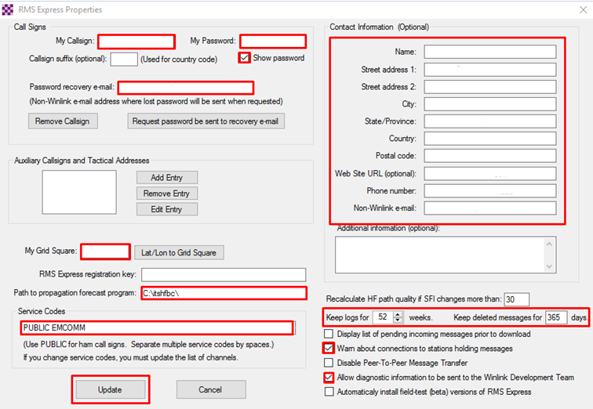
Winlink Express (latest ver. 1.3.14.0)
Typical Properties Setup
Add your information. (you will need to be on the internet):
Grid Square go to www.levinecentral.com/ham/grid_square.php
Enter address & Submit and it will show on the map.

Slide 13
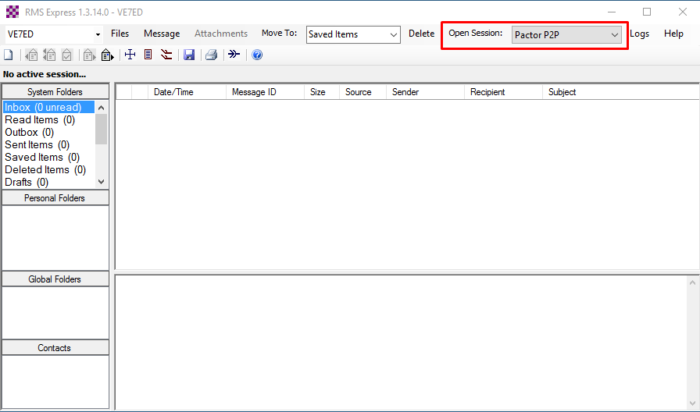
Winlink Express (latest ver. 1.3.14.0)
Open – Pactor P2P Session

Slide 14
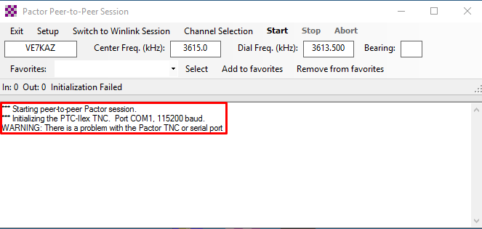
Winlink Express (latest ver. 1.3.14.0)
Pactor P2P Session – TNC start initialization ERROR
You most likely will get an error during initialization
we will fix this in the following slides

Slide 15
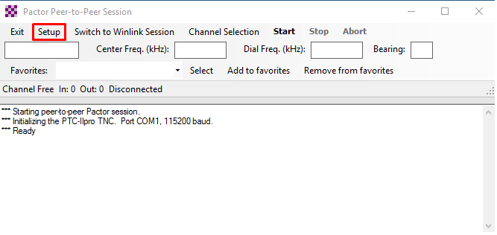
Winlink Express (latest ver. 1.3.14.0)
Pactor P2P Session – TNC parameter Setup
Click on the Setup tab

Slide 16
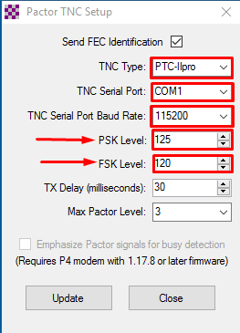
Winlink Express (latest ver. 1.3.14.0)
Pactor P2P Session – TNC setup
Change the following to the same as your info.
Note: PSK is first followed by FSK
(In Airmail they were reversed so enter FSK to FSK and PSK to PSK)

Slide 17
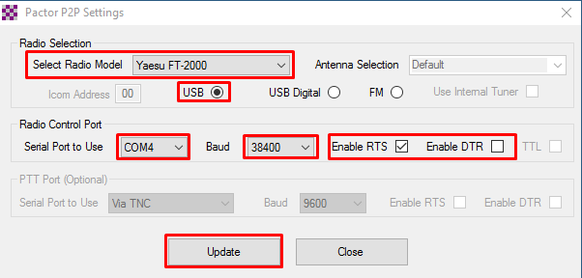
Winlink Express (latest ver. 1.3.14.0)
Pactor P2P Session – HF Radio Control Setup
Your parameters may vary…
Enter your - Port, Speed, Type of HF Radio etc.

Slide 18
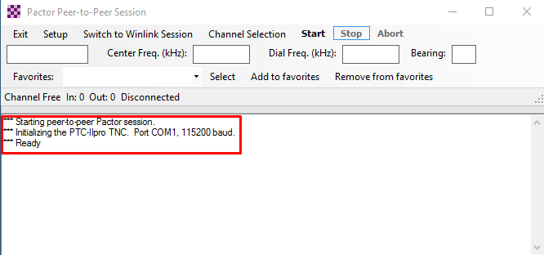
Winlink Express (latest ver. 1.3.14.0)
Pactor P2P Session – TNC initialization OK

Slide 19
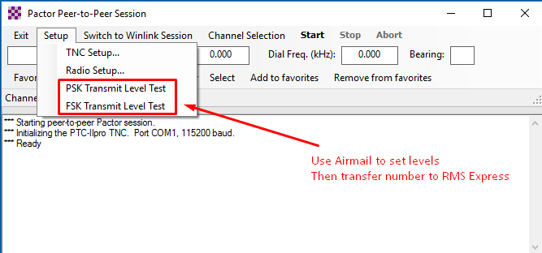
Winlink Express (latest ver. 1.3.14.0)
Pactor P2P Session – TNC to Radio Level Setup
The Airmail numbers get you close to No ALC easier than using RMS Express does
Test using the Winlink Express Level test and do a final adjust for NO ALC
Exit the program to save the parameters

